Slide 1
Unlocking Affordable Airbnb Stays Worldwide: A Data Analysis
NIDHISH ABHIJIT GORE

Slide 2
Our aim
Determine the Definition of "Affordable" Airbnb
Compare Airbnb Costs by Country
Assess Amenities within Budget Constraints
Categorize Types of Airbnb Accommodations

Slide 3
OVERVIEW OF DATASET
1. Amenities
4. PROPERTY details
Internet, TV, Heating, Air-conditioning, Washer, Kitchen, Smoke detectors, Bathroom amenities, Pet friendly.
Property type, Room type, Accommodates, Bathrooms, Bedrooms, Beds, Bed types, Minimum nights, Maximum nights, Cancellation policy.
2. Host features
5. Price and availability
Has profile pic, Is super host, Identity verified, Location exact, Instant bookable, Required guest profile picture, Require guest phone verification, Requires license.
Price, Security deposit, Cleaning fee, Availability 30,60,90 and 365.
6. Reviews and listing counts
3. locations
Number of reviews, Last review, First review, Review scores, Reviews per month, Host listing counts.
Street, Neighbourhood, City, State, Zip code, Country code, Country, Latitude, Longitude.

Slide 4
Overview of cleaning done to dataset
Variable | Changes
Amenities | Unique columns with different amenities (TV, Internet, etc)
Host Features | Divided host features in individual columns (Host Since, Superhost, etc)
Experienced Offered | Changed NA to none & replaced 1 with none
Host Response Time | Changed within an hour to 1 Hour
 | within a few hours to Few Hours
 | within a day to 1 Day
 | a few days or more to Few Days

Slide 5
Overview of cleaning done to dataset
Host Response Time | Filled NA to 100
Host Acceptance Rate | Replaced Apartment to 100
Country | Checked corresponding lat lon and filled 0 to United States
Neighbourhood Cleansed | Filled Na to 0
Price | Dropped the NA rows
Country | Replaced NA with Italy after checking corresponding city state.

Slide 6
Overview of cleaning done to dataset
Cancellation Policy | Strict_new to Strict
 | Moderate_new to moderate
 | Flexible_new to flexible
 | Super_strict_60_new to Super_strict_60
 | Super_strict_30_new to Super_strict_30
Has Availability | Changed t to True
 | 0.21 to False
 | NA to False

Slide 7
Data after cleaning
So, after cleaning the dataset the shape of the it has changed from (494954, 89) to (486996, 75).
We dropped few columns and added few new columns.
We have 75 attributes after adding all the features, amenities, dropping off the column and dropping the null values of the price column

Slide 8

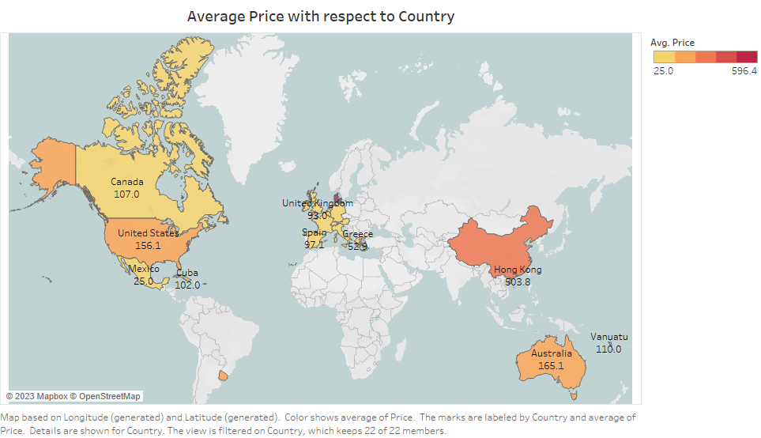
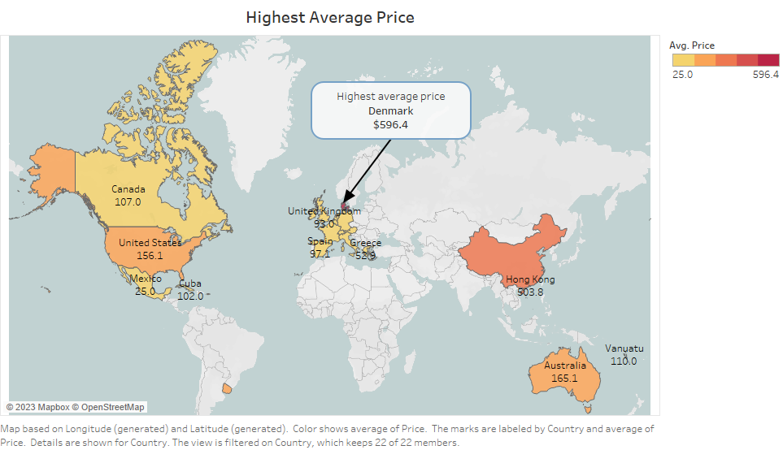
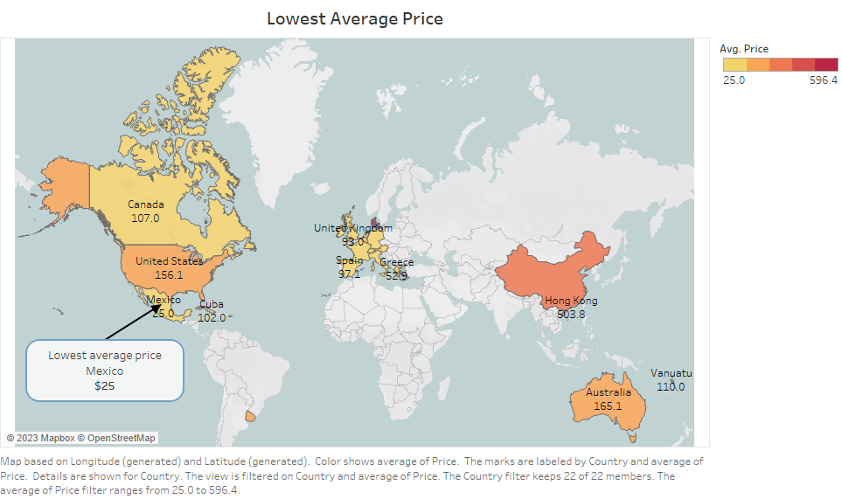

Slide 9
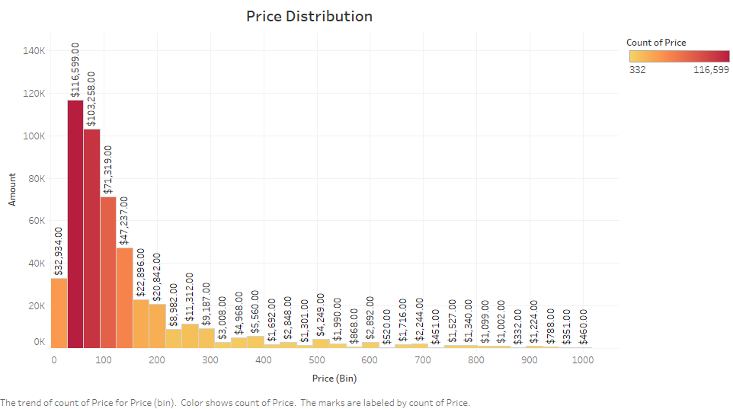
What’s the price distribution?

Slide 10
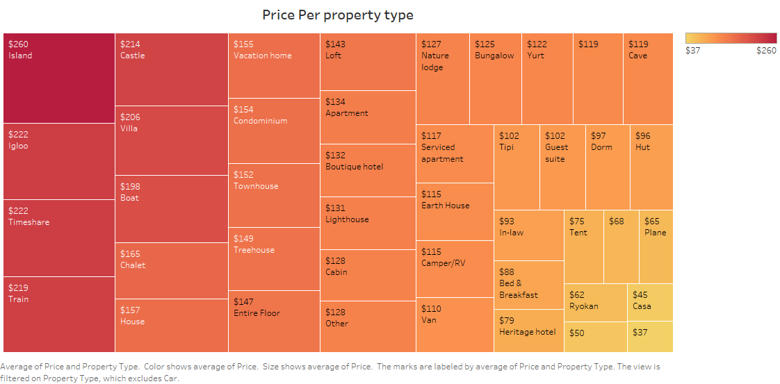
Let’s see the types of property!

Slide 11
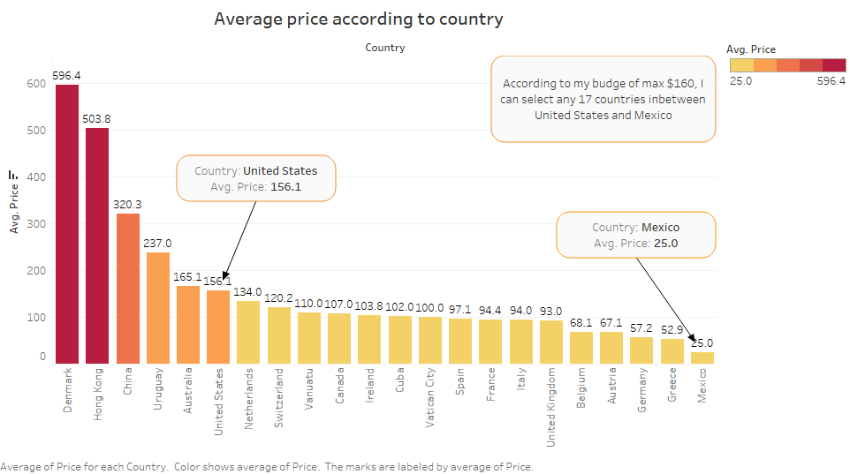
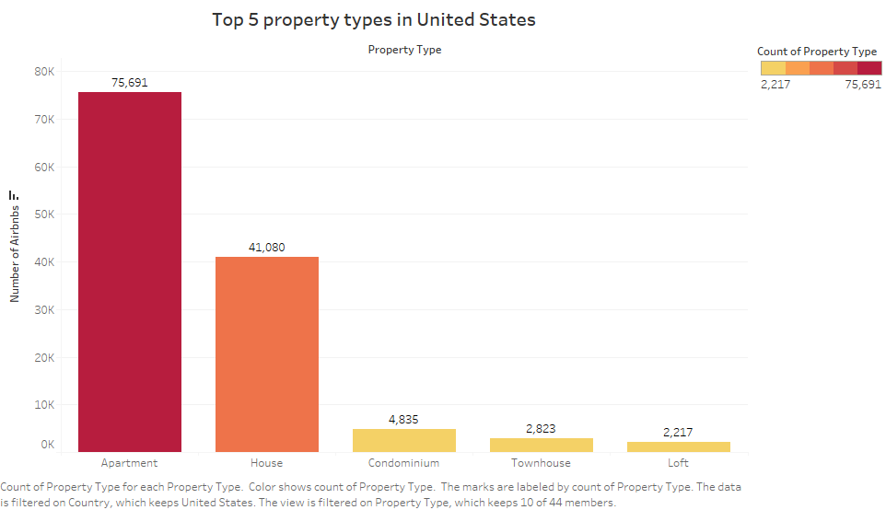
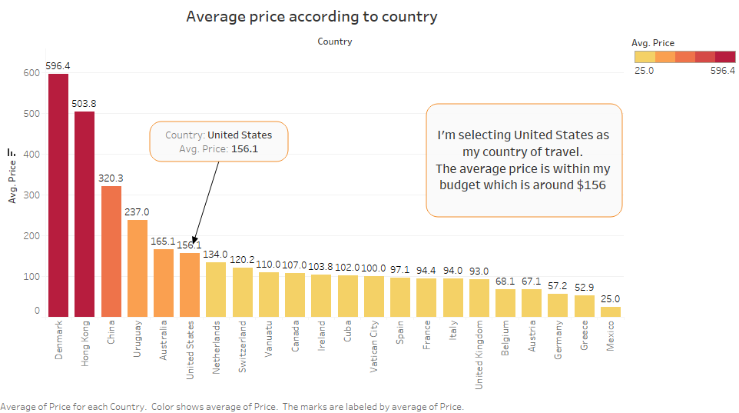
Let’s see the average price!

Slide 12
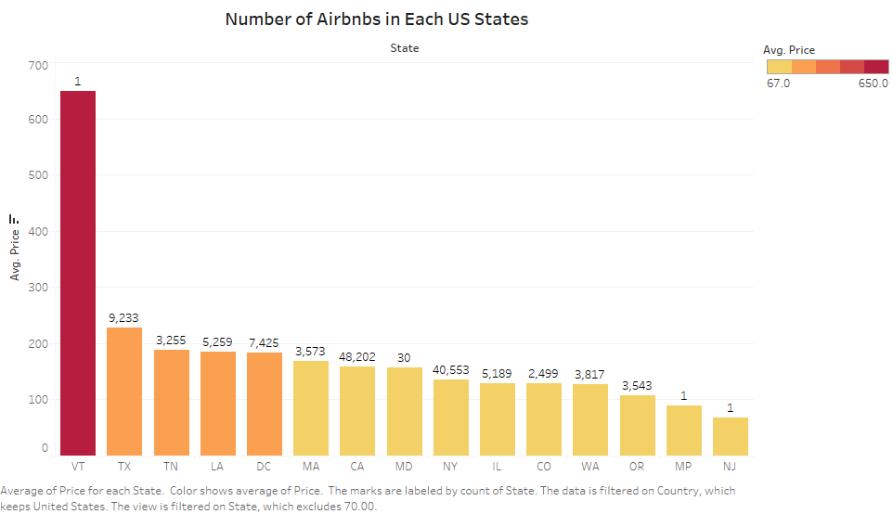
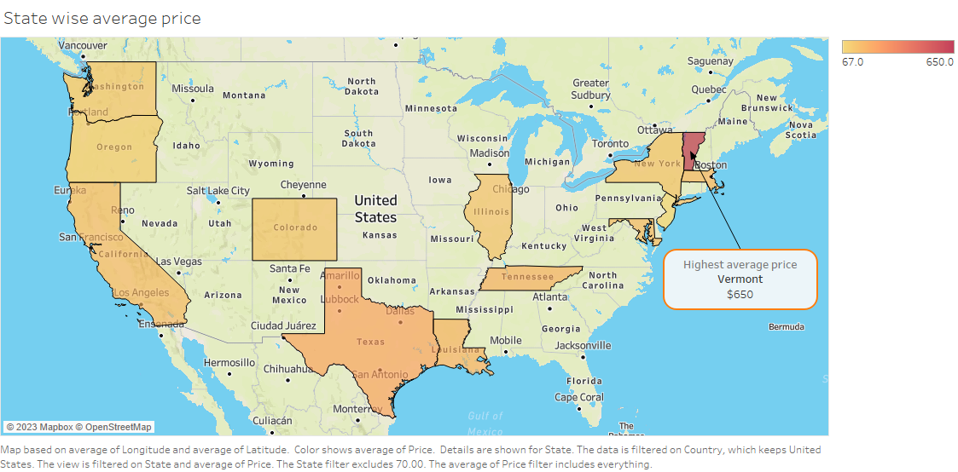
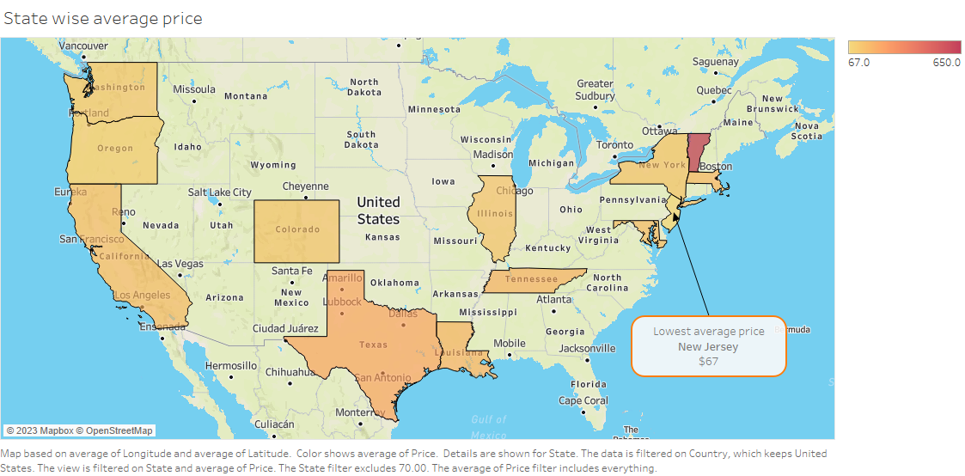
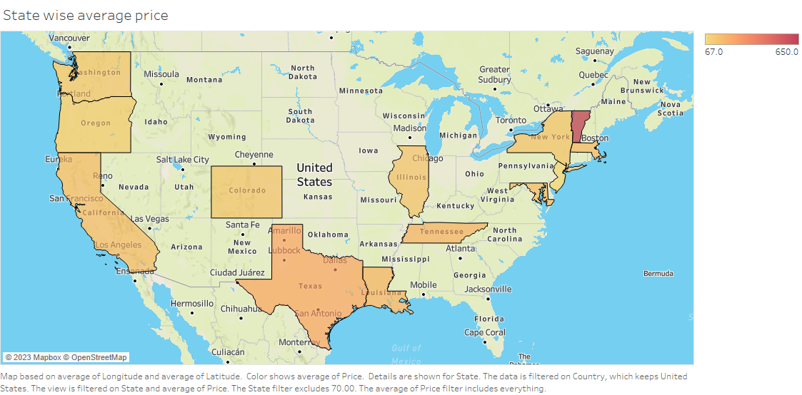
average airbnb prices in us states

Slide 13
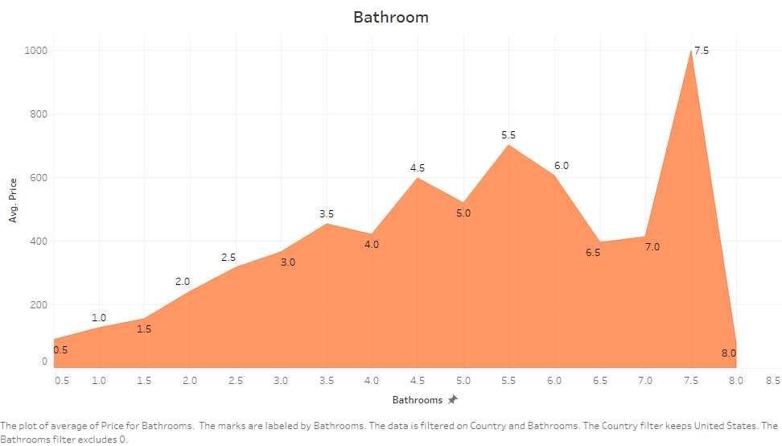
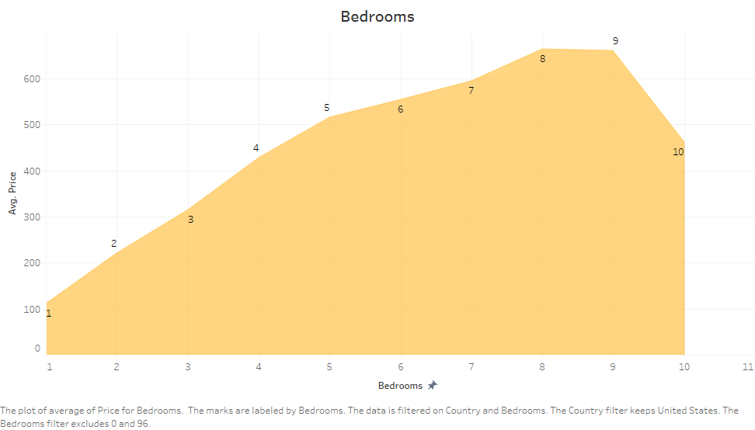
Let’s check the bedrooms
And bathrooms

Slide 14
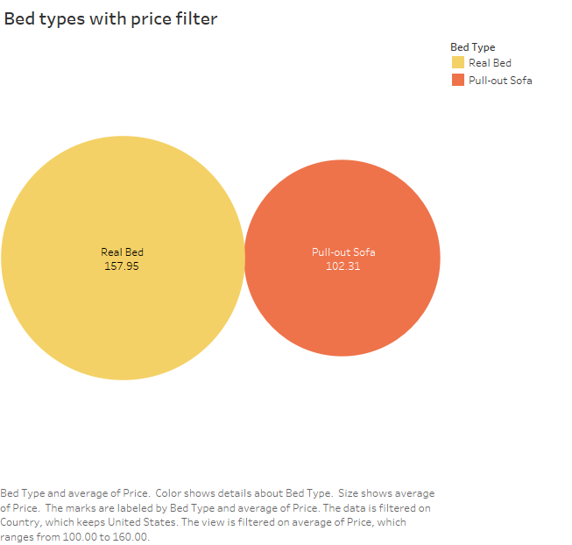
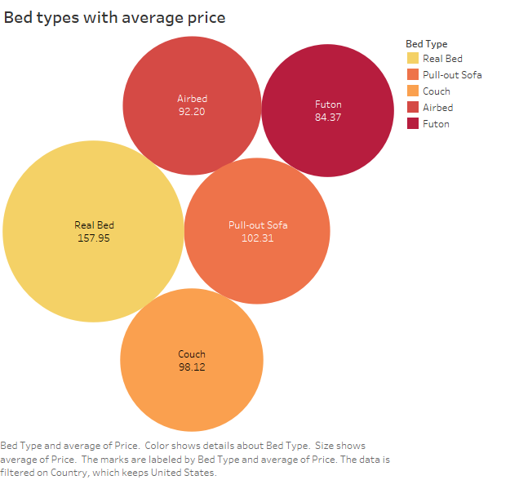
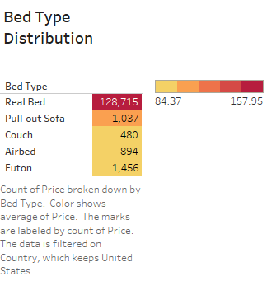
Bed types?

Slide 15
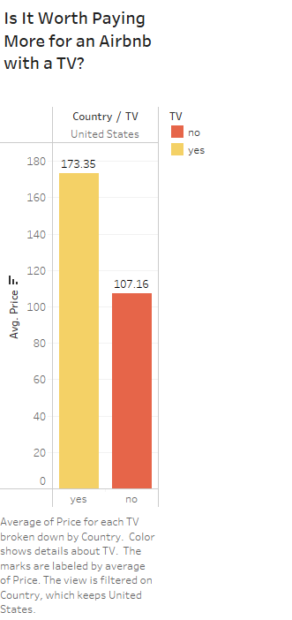
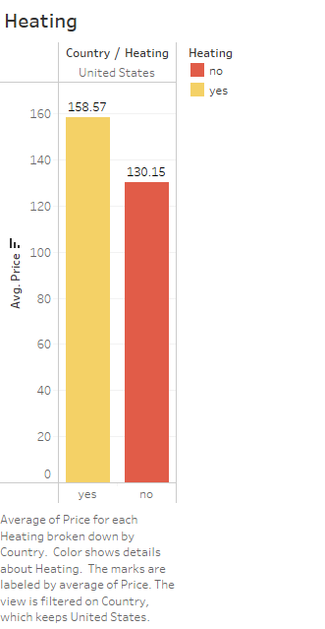
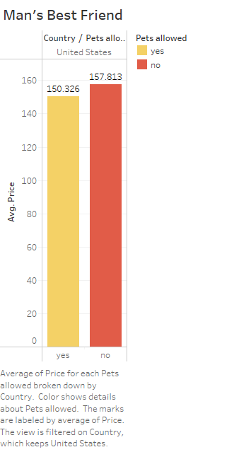
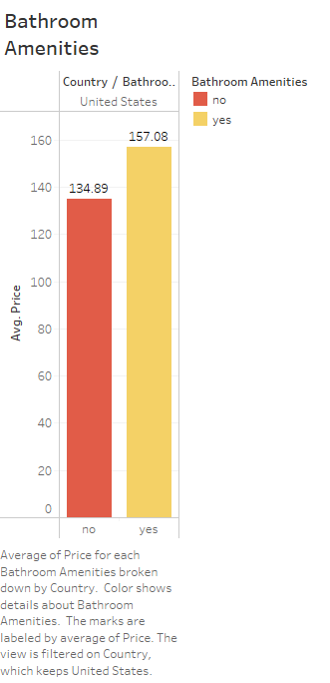
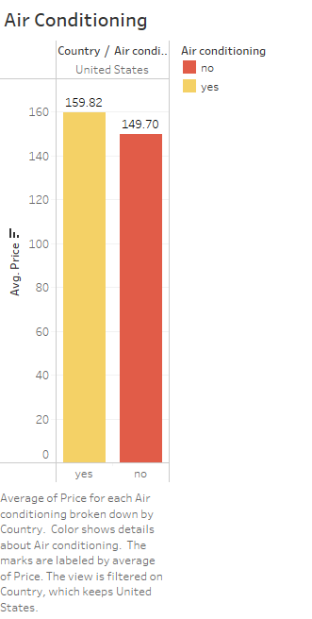
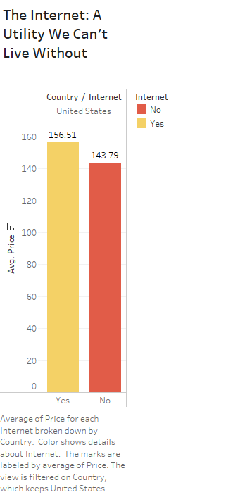
The truth about airbnb amenities

Slide 16
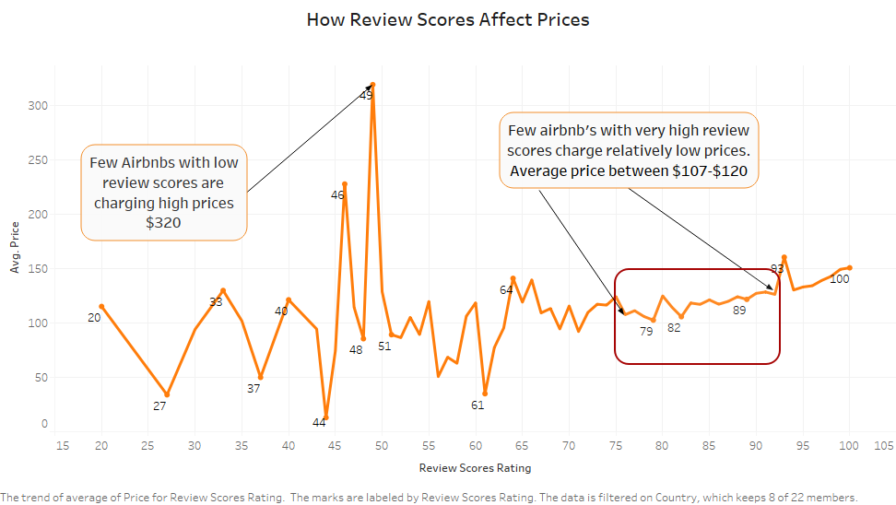
some review stats!

Slide 17
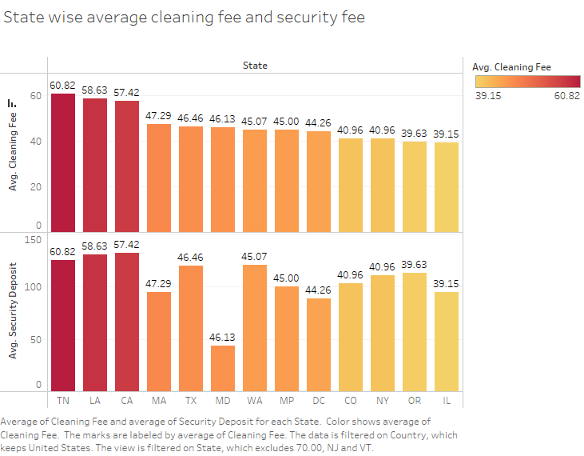
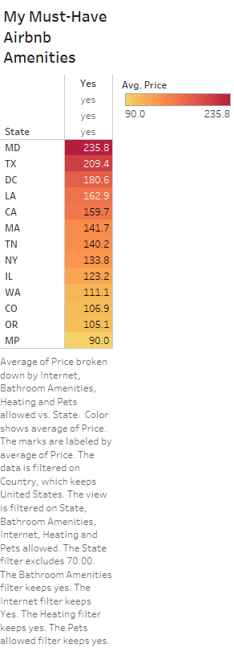
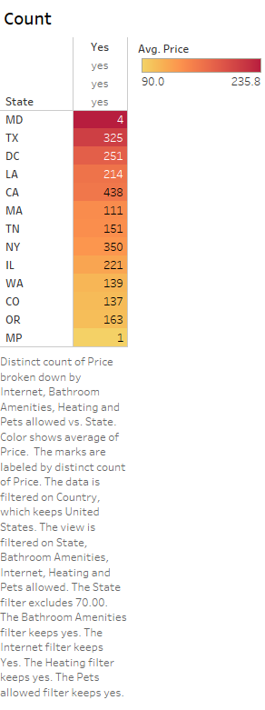
Average airbnb price by must-have amenities
Internet
Heating
Pets allowed
Bathroom amenities
Selecting the states which have all of my amenities.

Slide 18
Analysis part -2 price prediction model
NIDHISH ABHIJIT GORE

Slide 19
OVERVIEW OF DATASET
Information related to Airbnb listings
Input Variables
After filtering the data according to US as country, we have -
It’s (132582 , 74)
Experienced Offered
Host ID
Host Since
Output Variable
Host Response Time
Predicted_Price
Require Guest Phone Verification
Requires License

Slide 20
Details of our dataset
Host Details
Host ID, Host Since, Host Response Time,
Host Response Rate, Host Total Listings Count
Attributes: 72 Independent and 1 Dependent
Address Information
Data Type:
Object – 39
Integer – 27
Float – 5
DateTime – 3
Boolean - 1
Street, Neighbourhood, Neighbourhood Cleansed,
City, State, Zipcode, Country, Latitude, Longitude
Property Details
Property Type, Room Type, Accommodate, Bathrooms,
Bedrooms, Beds, Bed Type
Amenities
TV, Internet, Kitchen, Heating, AC, Washer,
Breakfast, Pets Allowed, 24 Hour Check-in

Slide 21
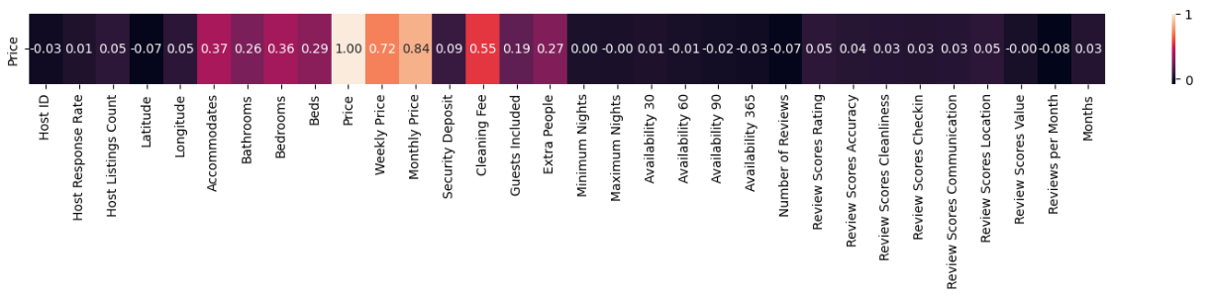
Dropping columns
Host Since
Host ID
First Review
Last Review
Experience Offered
Street
Neighbourhood
Neighbourhood Cleansed
Country
Carnbon Monoxide detector
Elevator In Building
Instant Bookable
Require Guest Profile Picture
Require Guest Phone Verification
Requires License
Host Profile Pic
Splitting Dependent and Independent Variable
Attributes: 57 Independent and 1 Dependent

Slide 22
One Hot Encoding
Categorical variables present in the dataset like – City, State, Bed Type, TV, Internet
Total Categorical variable – 26(Object)
For us to run regression models, we need to convert this variables into numbers.
We convert each categorical value into a new categorical column and assign a binary value of 1
A example from our dataset -
Dataset after One
Hot Encoding
Original
One Hot Encoded
Bed Type
Entire home/apt
Private room
Shared Room
Bed Type | Entire home/apt | Private room | Shared room
Entire home/apt | 1 | 0 | 0
Private room | 0 | 1 | 0
Shared Room | 0 | 0 | 1
Shape : (132582, 1129)

Slide 23
Data Splitting
Splitting the dataset into two different dataset
Training Dataset – 75%
Validation Dataset – 25%
Shape of training data set after one hot encoding and data splitting
(99436, 1129)
Shape of validation data set after one hot encoding and data splitting
(33146, 1129)
Scalling – standard
Standardization preserves meaningful differences between values,
which is important in context of price prediction
Standardization is less affected by outliers compared to normalization
Standardization is less prone to data leakages.

Slide 24
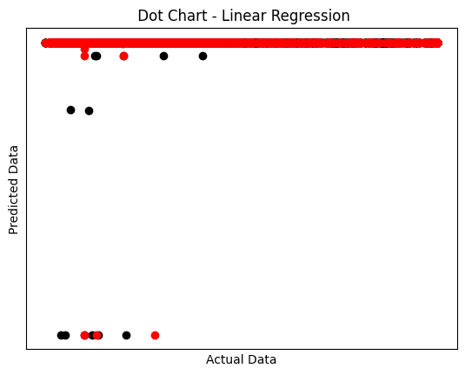
Principal component analysis (PCA)
PCA used for feature extraction and dimensionality
reduction.
Very low co-efficient of determination for Training as
Well as validation data
Training data -Mean squared error: 18833.54
Validation data - Mean squared error: 18345.74
Training data Coefficient of determination: 0.00
Validation data Coefficient of determination: -0.00

Slide 25
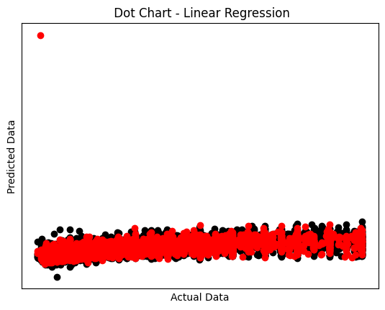
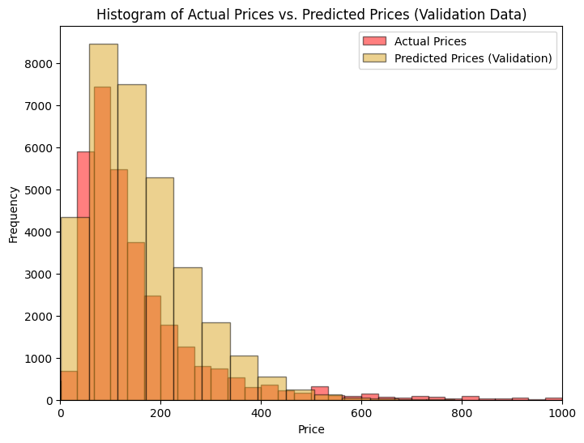
Regression analysis
Training data -Mean squared error: 8138.14
Validation data - Mean squared error: 8869.18
Training data Coefficient of determination: 0.57
Validation data Coefficient of determination: 0.52
Adjusted R2 for Training data: 0.56
Adjusted R2 for Validation data: 0.50

Slide 26
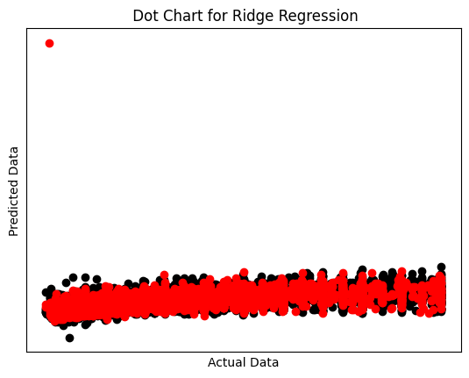
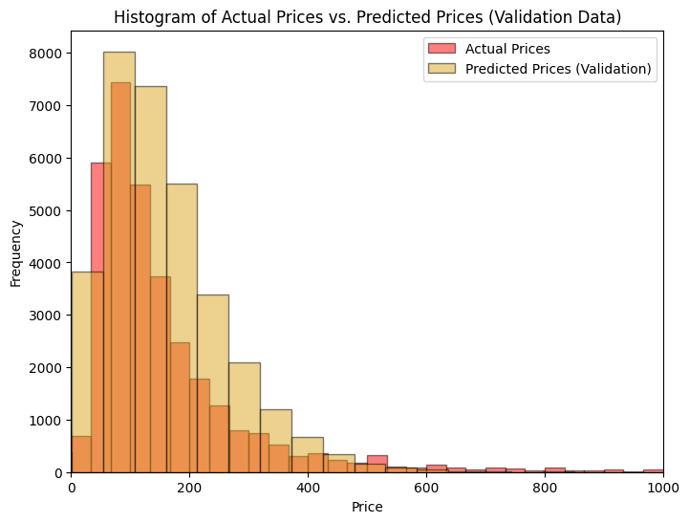
Regression analysis
Training data -Mean squared error: 8163.59
Validation data - Mean squared error: 8762.34
Training data R2 Score: 0.57
Validation data R2 Score: 0.52
Adjusted R2 for Training data: 0.56 Adjusted R2 for Validation data: 0.51

Slide 27

Regression analysis
Training data -Mean squared error: 8147.30
Validation data - Mean squared error: 8812.41
Training data R2 Score: 0.57
Validation data R2 Score: 0.52
Adjusted R2 for Training data: 0.56
Adjusted R2 for Validation data: 0.50

Slide 28
Regression analysis
Models | MSE (Training) | MSE (Validation) | R2 (Training) | R2 (Validation) | Adj. R2 (Training) | Adj. R2 (Validation)
Linear Regression | 8183.14 | 8869.18 | 0.57 | 0.52 | 0.56 | 0.50
Ridge Regression | 8163.59 | 8762.34 | 0.57 | 0.52 | 0.56 | 0.51
Lasso Regression | 8147.30 | 8812.41 | 0.57 | 0.52 | 0.56 | 0.50
Ridge regression is the best model, so proceding with
it for our price prediction
Deals with Multicollinearity
Flexible in handling large features
Prevents Overfitting
It gives a consistent output.

Slide 29
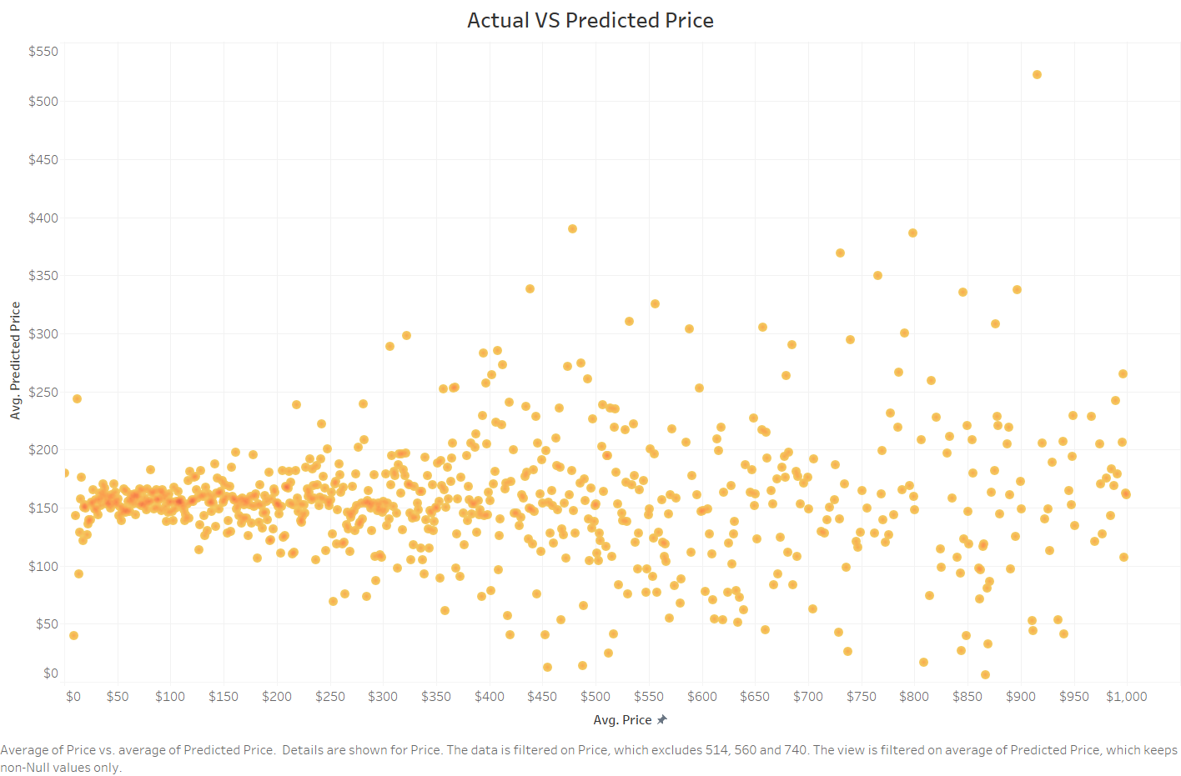
Comparing actual price with predicted price

Slide 30
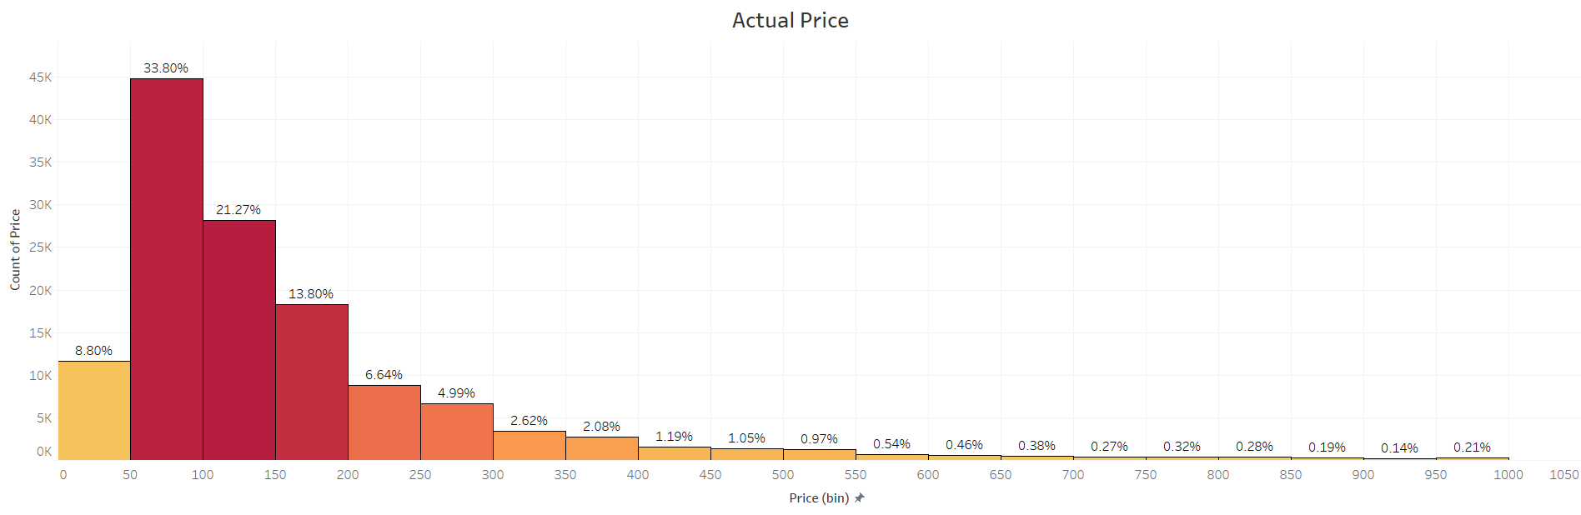
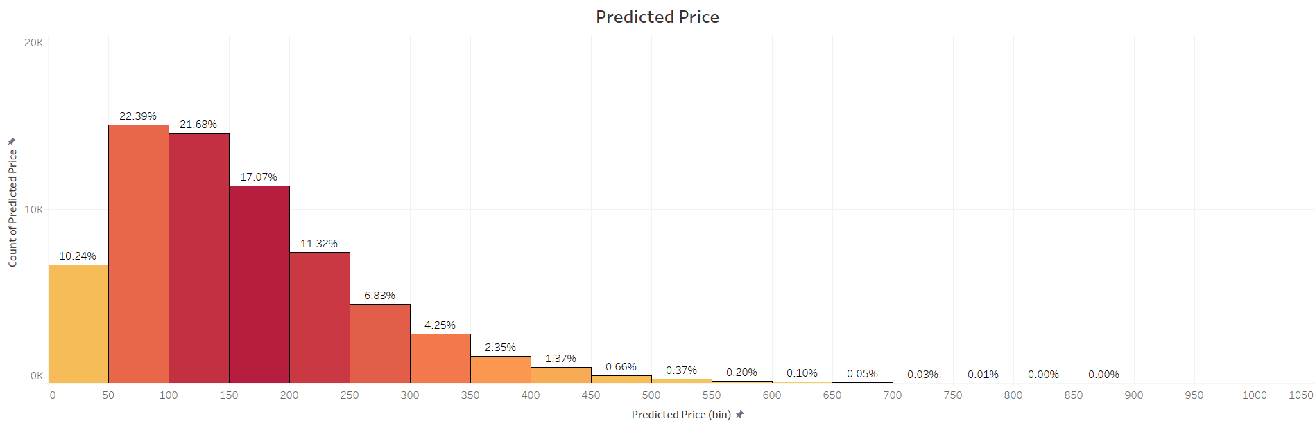
Comparing actual price with predicted price

Slide 31
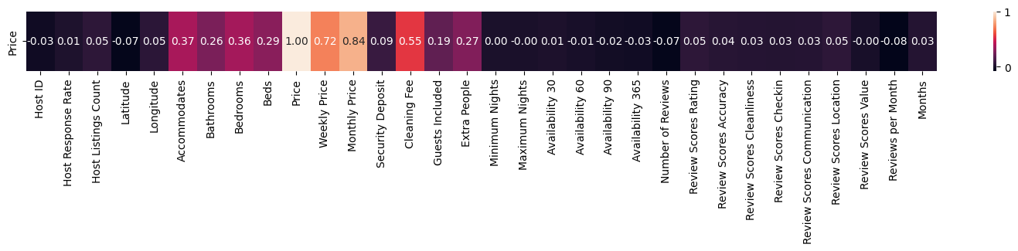
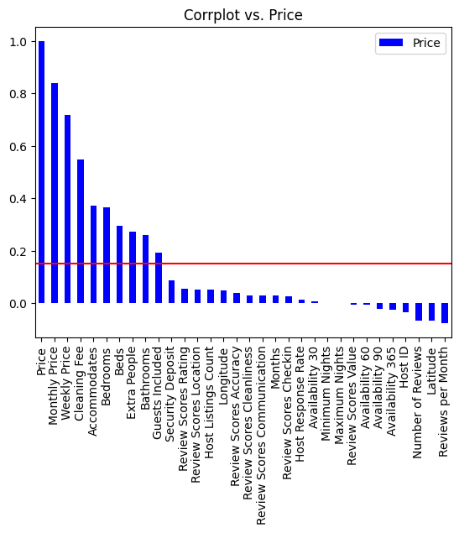
Checking co-relation
Top Varaibles
Accommodates
Bathrooms
Bedrooms
Beds
Extra People
Cleaning Fee

Slide 32
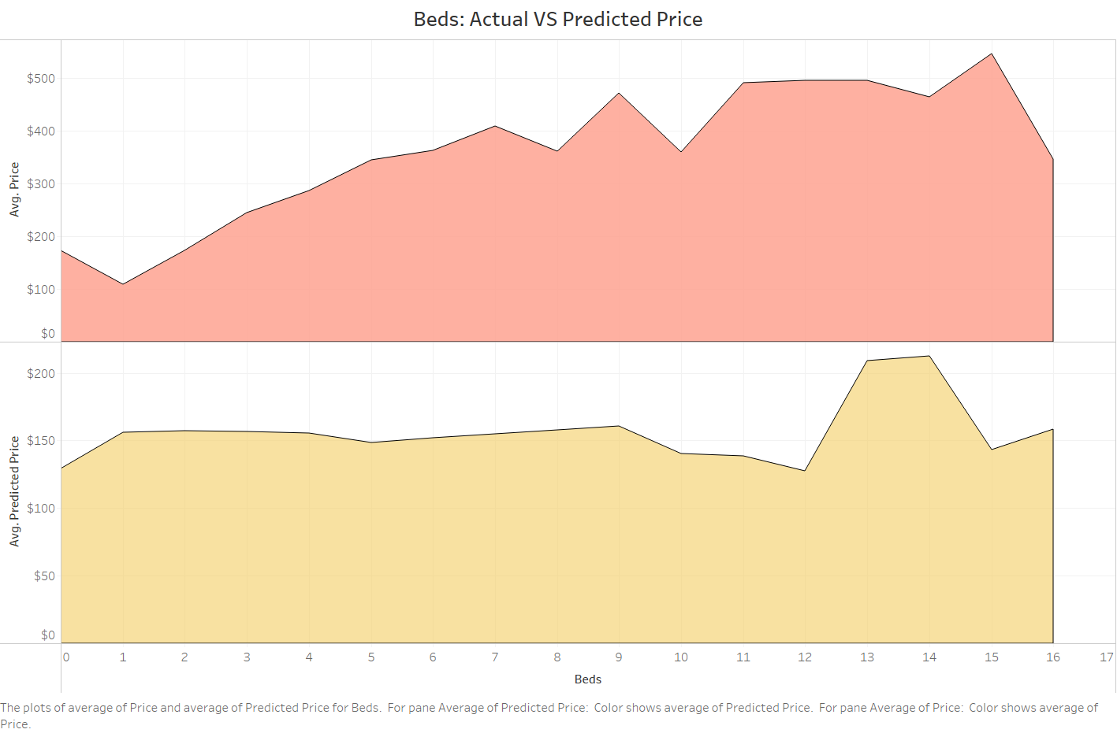

Slide 33
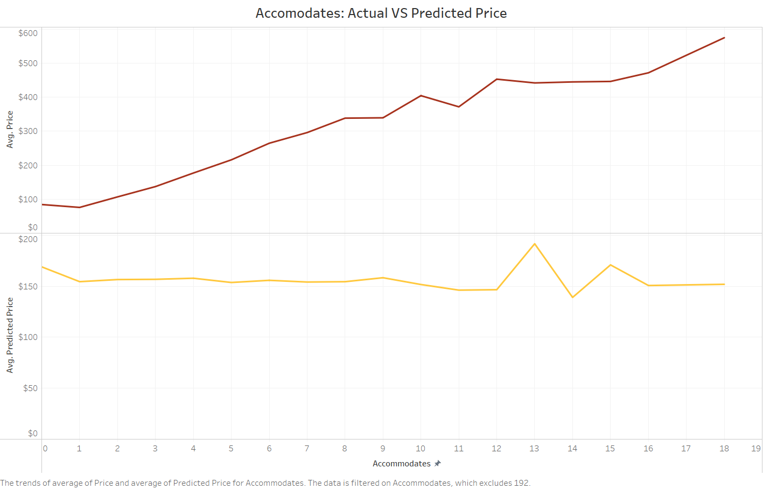

Slide 34
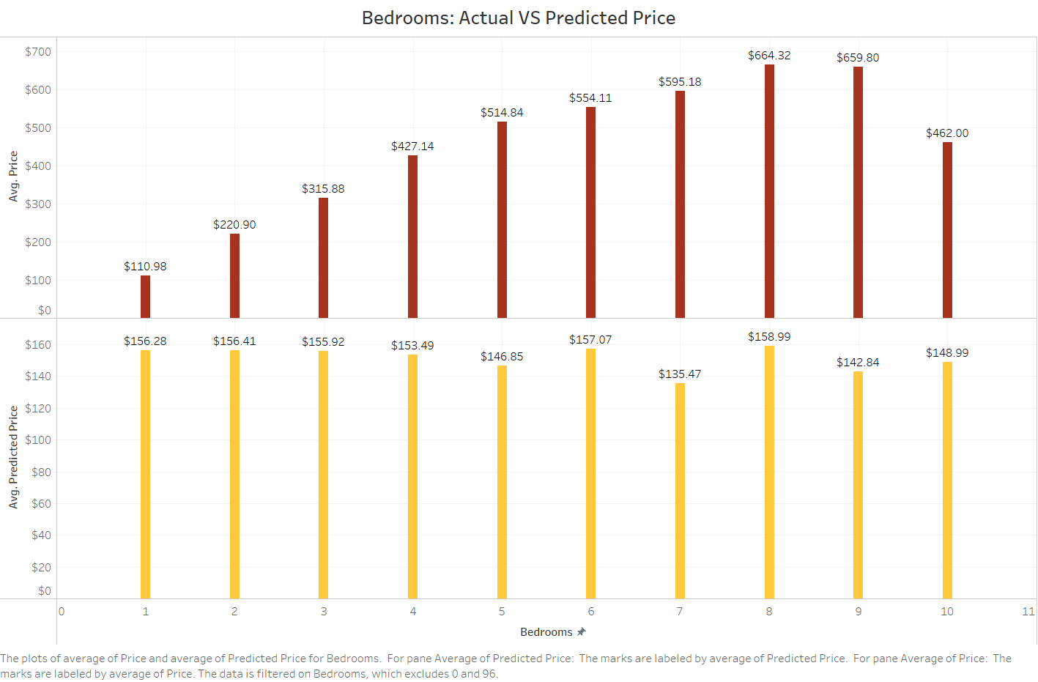

Slide 35
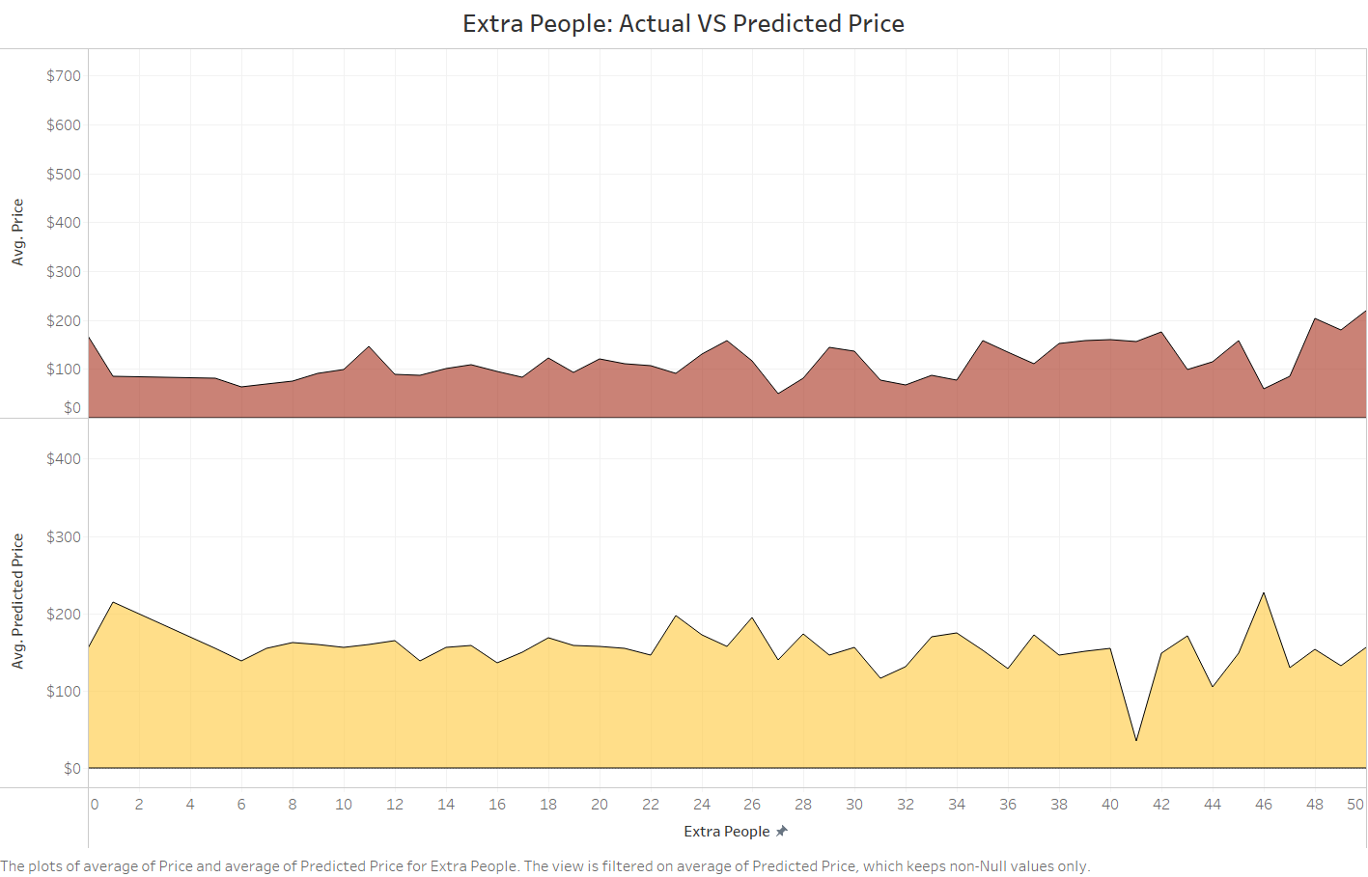

Slide 36
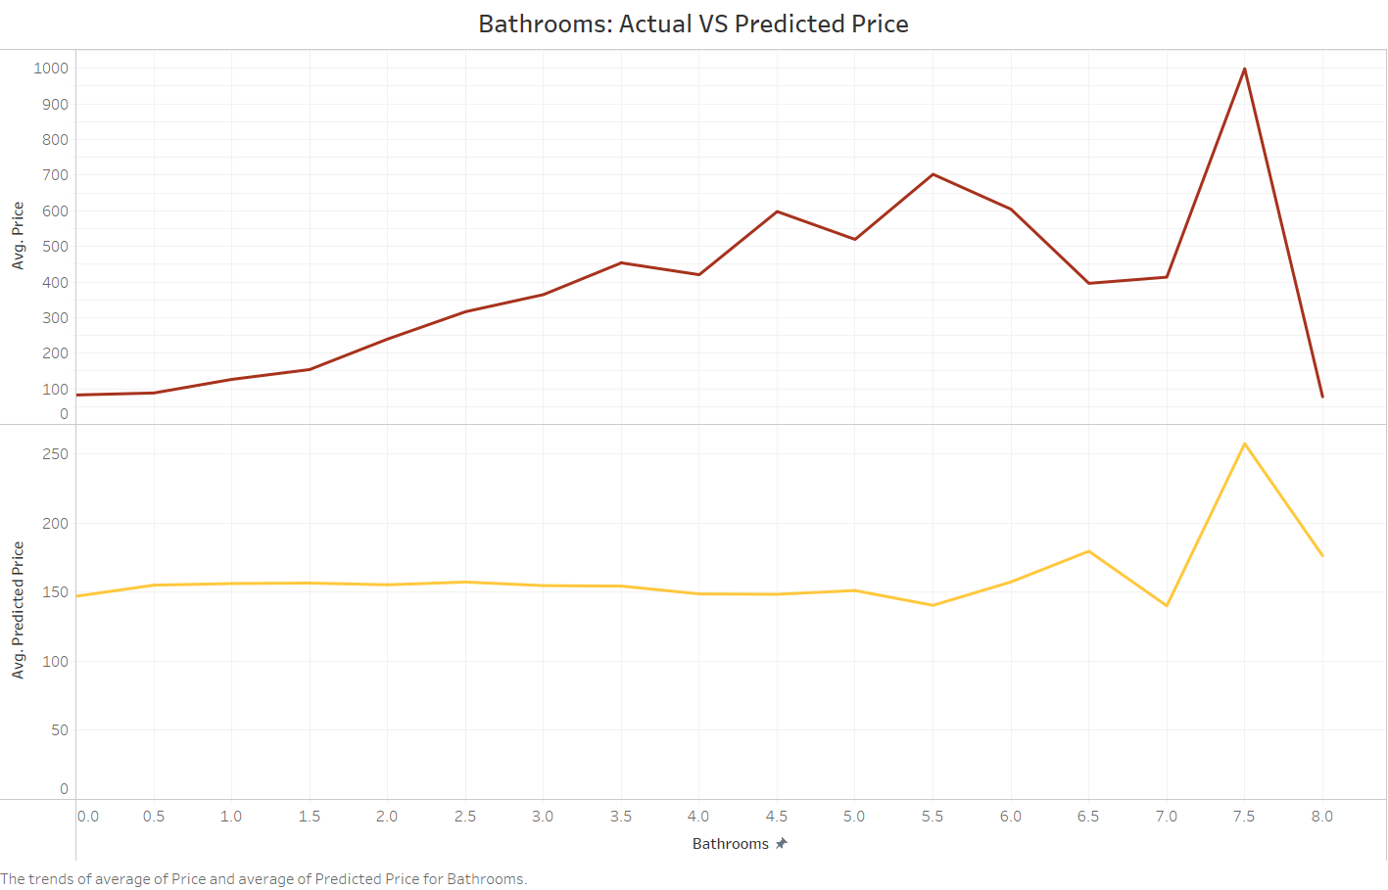

Slide 37
Thank you

Slide 38
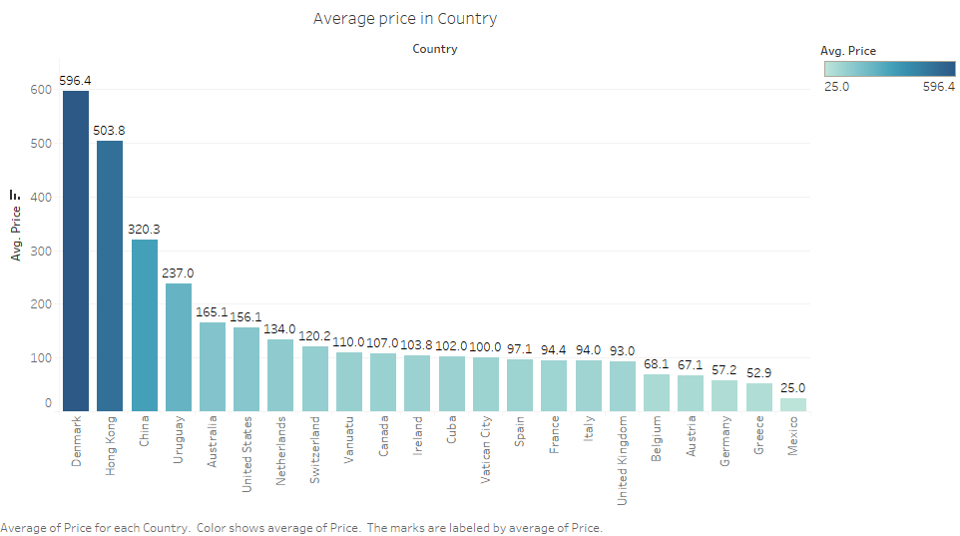
Let’s check the prices!

Slide 39
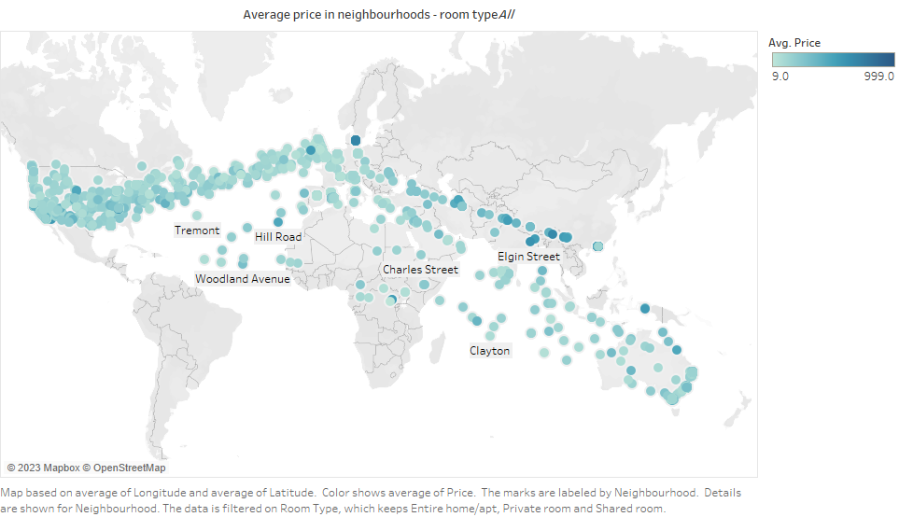
Let’s check the prices!

Slide 40
Data after cleaning

Slide 41
SUMMARY
At Contoso, we believe in giving 110%. By using energy efficient building methods, we help commercial businesses grow and foster a consumer first mindset. We thrive because of our market knowledge and a great team behind our product. As our CEO says, "Efficiencies will come from proactively transforming how we do business."

